Slide 1
ELK 구성 TEST 2

Slide 2
Test Flow
Dceng Web
Filebeat
Logstash
Http_access log
COMBINEDAPACHELOG
Visual Data
Kibana
Elasticsearch

Slide 3
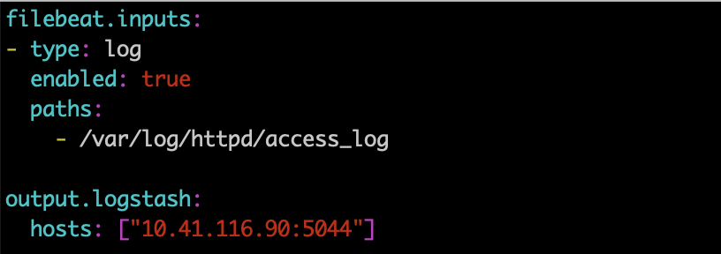
Filebeat Set
Filebeat Configure
Paths : $FILEBEAT_HOME/filebeat.yml
Input/Output 설정
EXEC : $FILEBEAT_HOME/filebeat –c [config filename]

Slide 4
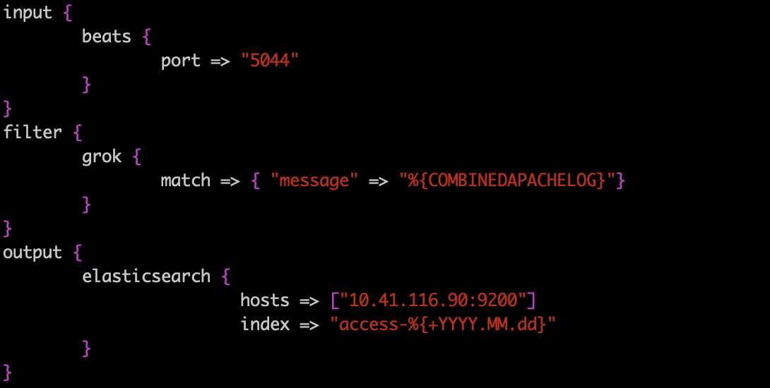
Logstash Set
Logstash Configure
- Paths : $LOGSTASH_HOME/config/logstash.yml(XXXXX.yml)
- COMBINEDAPACHELOG Patterns 사용.(Grok Patterns 참조)
- EXEC : $LOGSTASH_HOME/bin/logstash –f $LOGSTASH_HOME/config/[config filename]

Slide 5
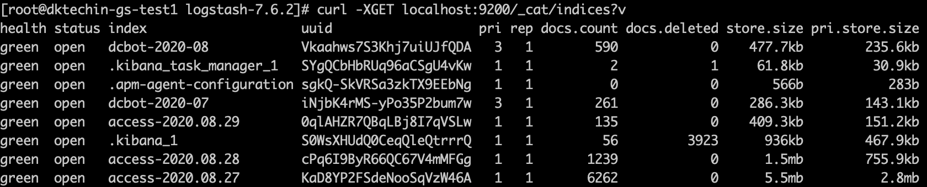
Elasticsearch Index
Elasticsearch Index 생성 확인.

Slide 6
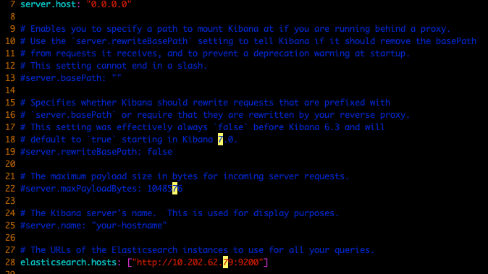
Kibana Set
Downloads URL
WGET : https://artifacts.elastic.co/downloads/kibana/kibana-7.6.2-linux-x86_64.tar.gz
Logstash Configure
- Paths : $KIBANA_HOME/config/Kibana.yml(XXXXX.yml)
Kibana에 연동할 Elasticsearch host 설정
- EXEC : $Kibana_Path/bin/kibana and $Kibana_Path/bin/kibana -–allow-root(root 실행 시)

Slide 7
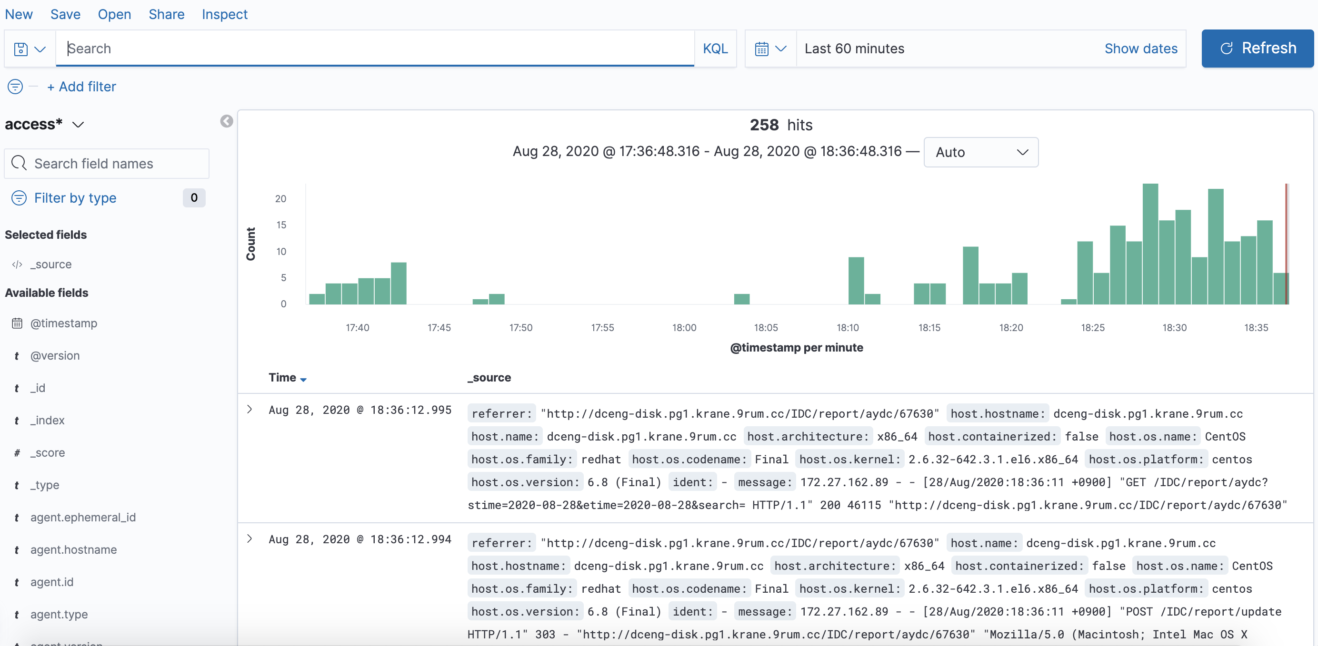
Kibana – Create Index Patterns

Slide 8
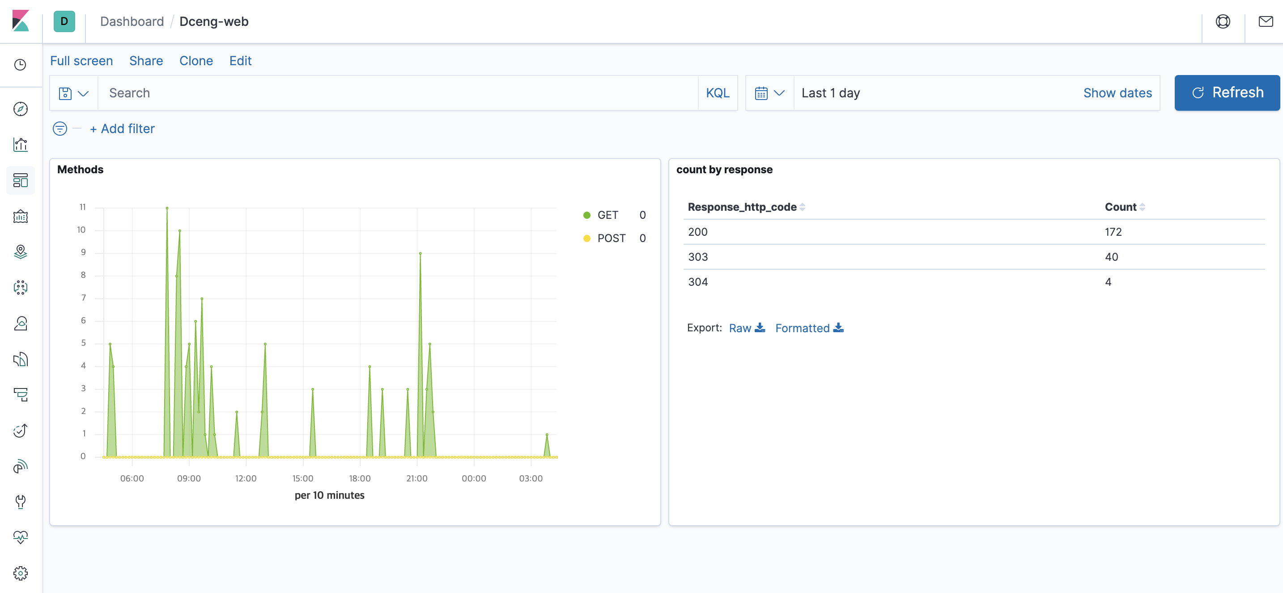
Kibana 활용

